Slide 1
“You can't do everything, but you can do something”
Notes:
This powerpoint presentation is to give a little insight about the role of NGOs’s in society, and about how all young people have a voice to be heard and a role to play in society, in tackling various social issues that we face, here in northern Ireland, and around the world. This presentation forms an introductory session to the five classes that have been created in this series.

Slide 2
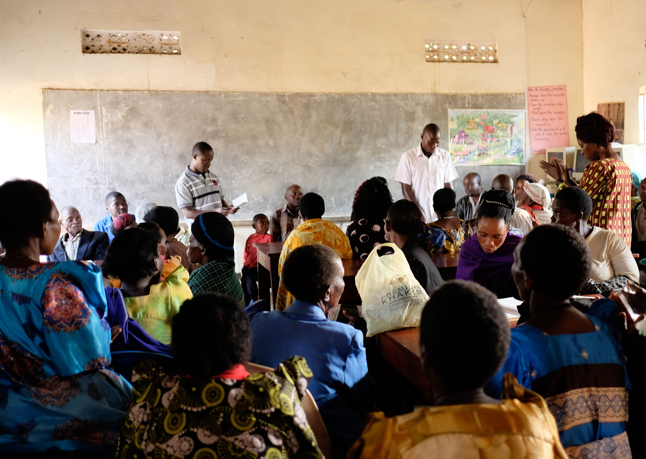
Inequality
Inequality is the difference in income, wealth, health, education, access to technology, opportunity and power among countries, communities and households around the world.
Can be caused by where you come from, your nationality, your race, your gender, your religion, your ethnicity, your identity
Notes:
One of the key things we were looking at in the series, is this idea of inequality.
Share Uganda works in tackling the healthcare inequality around the world, but there are so many different sources and types.
It is defined as the difference in income, wealth, health, education, access to technology, opportunity and power among countries, communities and households around the world. Inequality can be caused by where you come from, your nationality, your race, your gender, your religion, your ethnicity and your identity
It impacts each and every one of us on a daily basis in a variety of different ways. We need to be aware of this to be able to improve our lives and those of everyone around us.

Slide 3
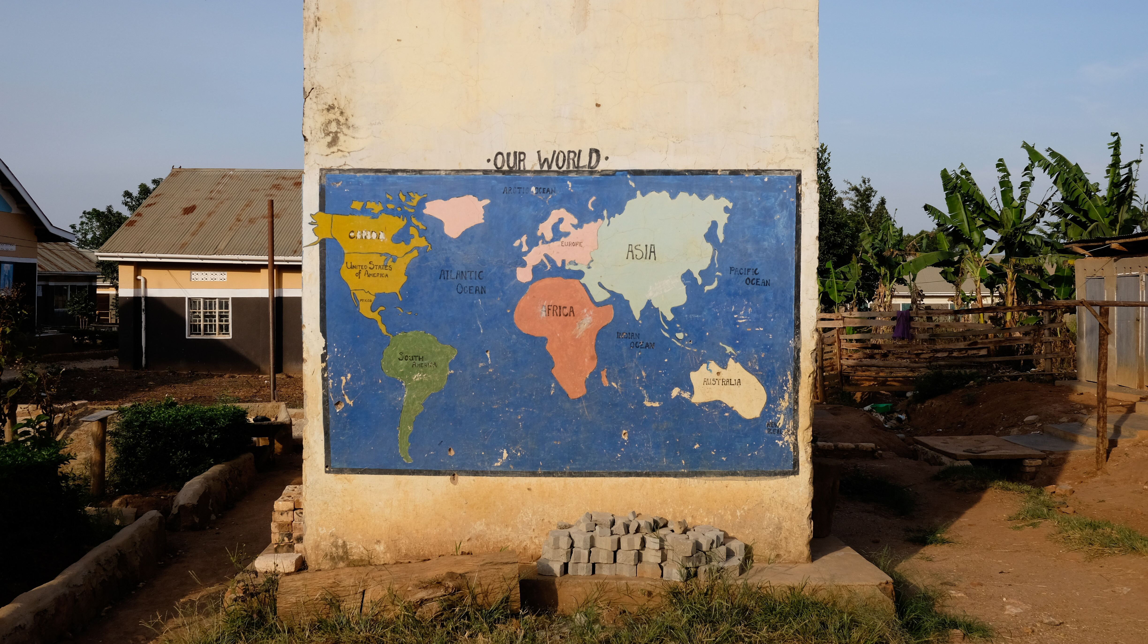
Social justice
Social justice is based on the concepts of human rights and equality.
It is about the way in which human rights are manifested in the everyday lives of people at every level of society.
Justice in terms of the distribution of wealth, opportunities, and privileges within a society.
Notes:
What can NGOs and Young people do then…..
We can focus our attention to this concept of social justice.
Social justice is understand as fairness based on the ideas of human rights, equality and equity. It is about the way in which human rights are manifested in the everyday lives of people at every level of society. It is about justice or fairness in how wealth, opportunities and privileges are distributed within a society.
Its important to remember that we all have our part to play in achieving social justice and that it is an ongoing process.

Slide 4
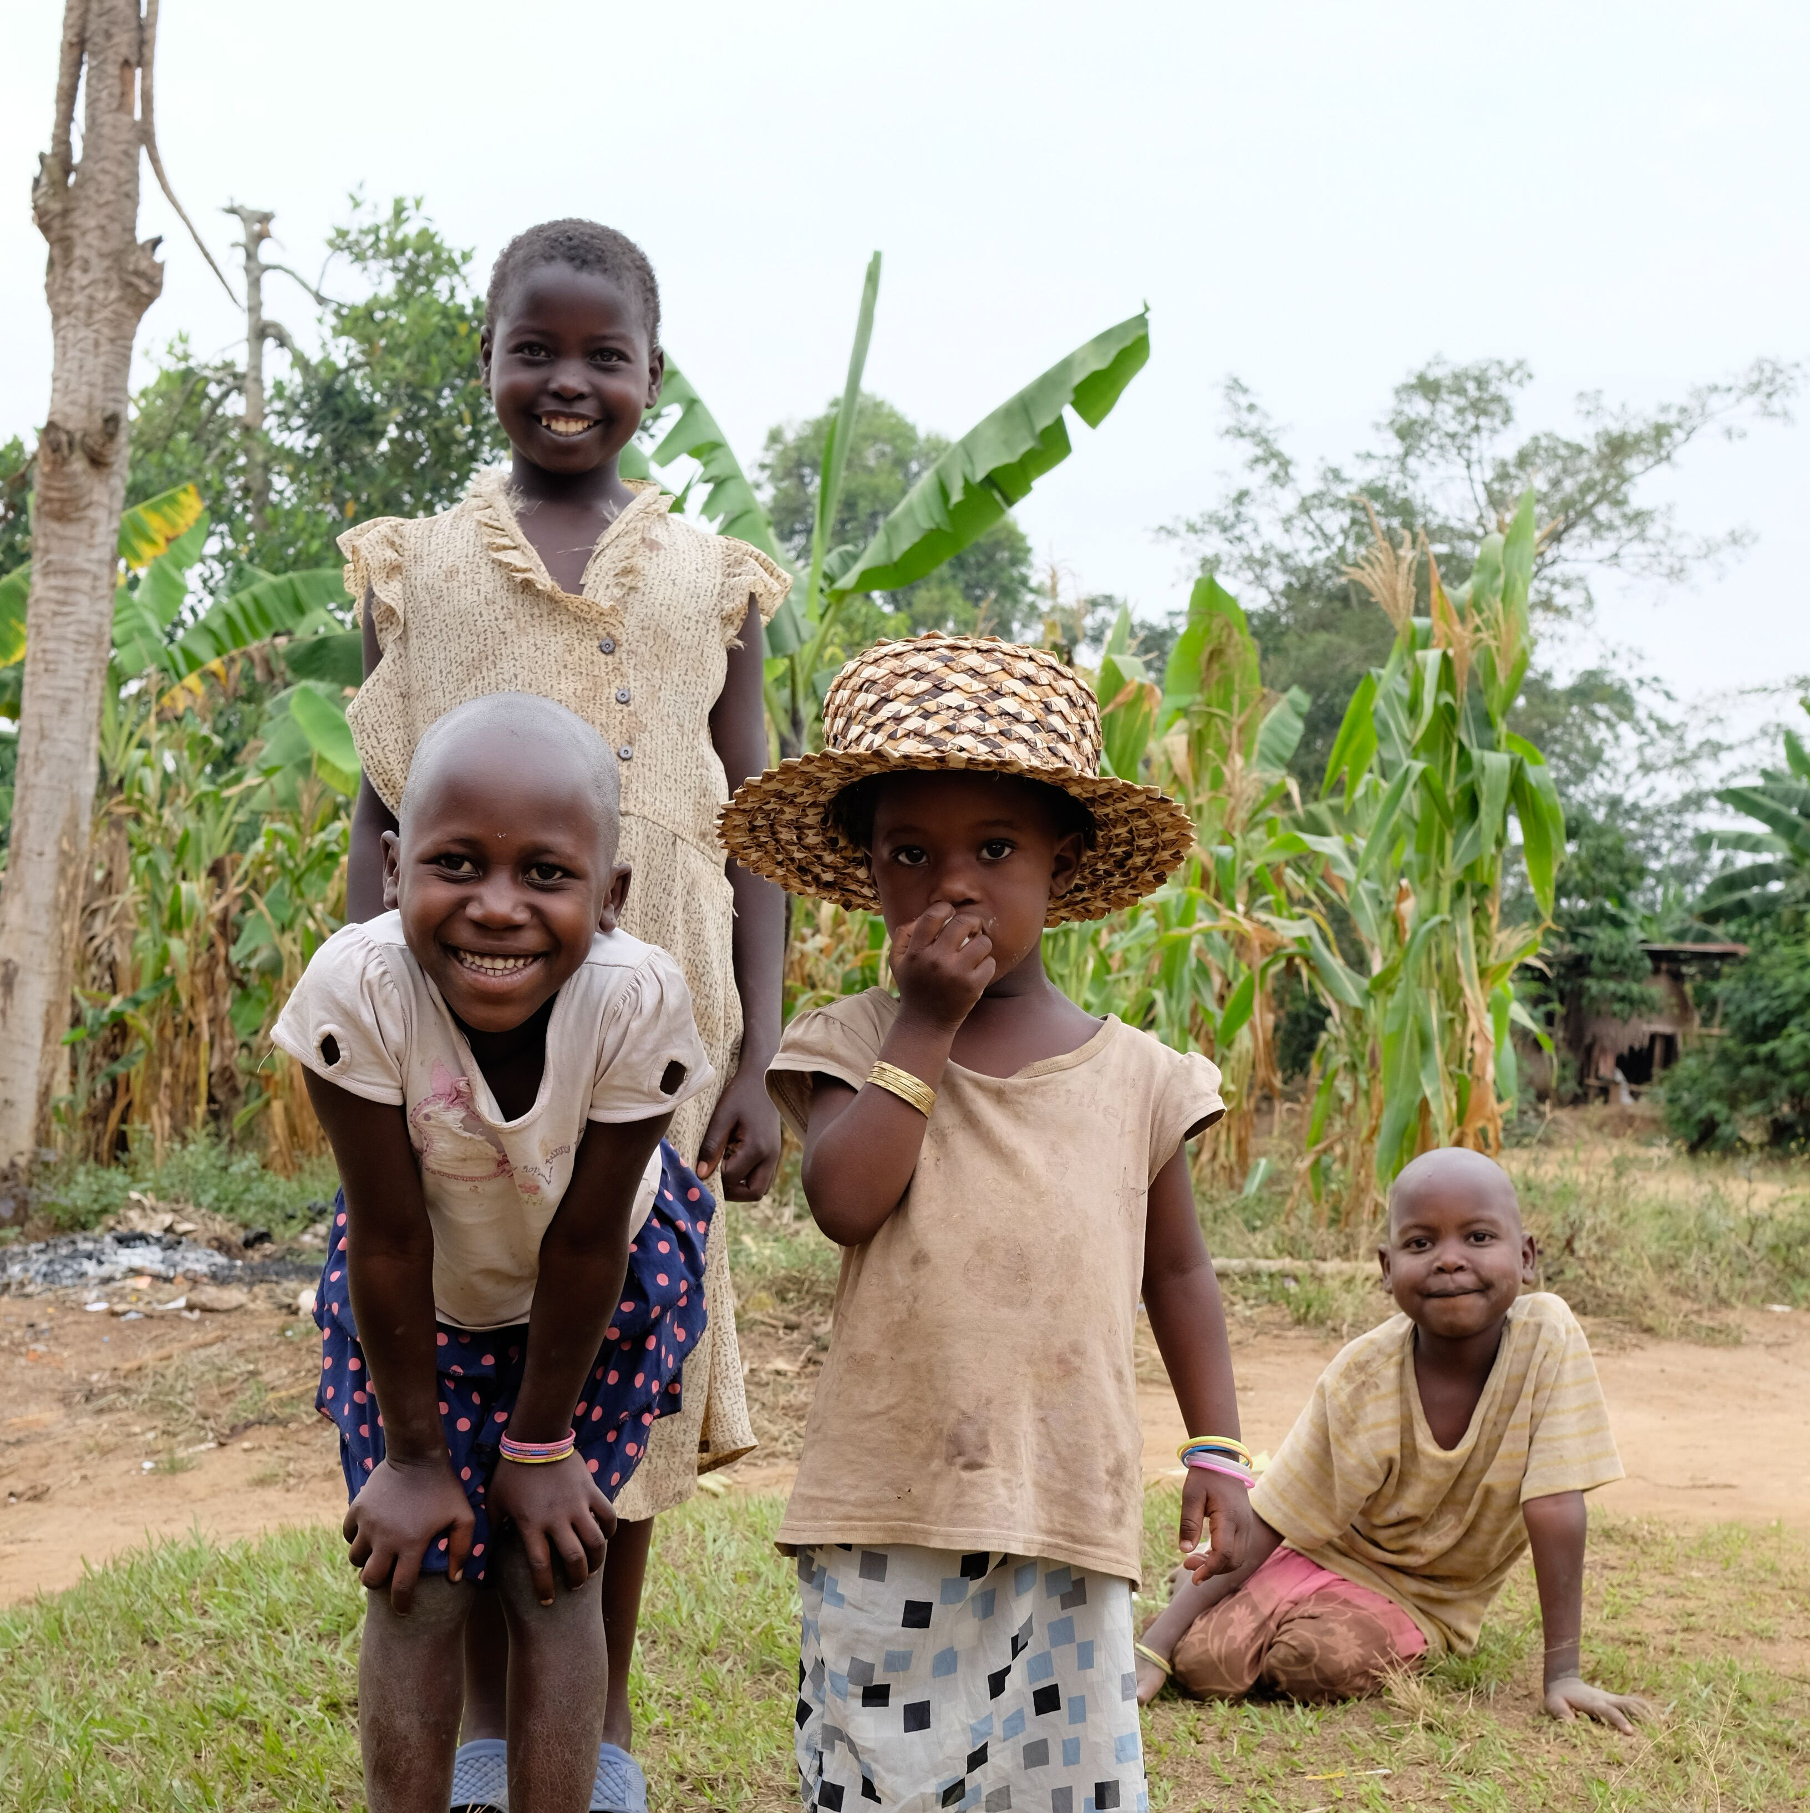
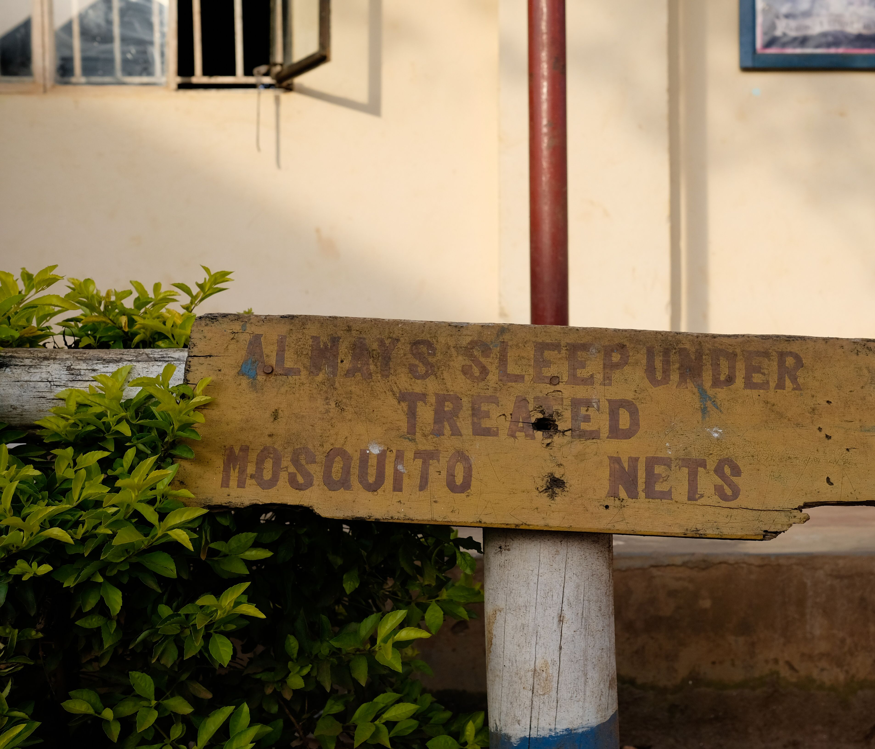
Share Uganda
Share Uganda is an entirely not-for-profit, community based healthcare organization working in the Kyotera District of Uganda.
The work carried out by Share Uganda focuses on tackling the inequality issue
Share Uganda was set up in 2008 by 5 students from Northern Ireland
2018, opening of the Share Uganda Hampton Health Centre
https://open.spotify.com/episode/3bpaxofITtc2p5JV28wBcb?si=p5v0VoGzReWyKs4Dkkb7VA
Notes:
Who are Share Uganda?
- We are an NGO;
Main issues to tackle include health care access and the malaria crisis. Including providing sustainable health services and supporting the education of local healthcare professionals
We distribute malaria nets, constructed a Medical camp , planted a forest of eucalyptus trees, initiated a malaria prevention programe, which has been incredibly successful.
We focus on the inequality issue surrounding healthcare, and access to healthcare. Its important to remember that the healthcare facilities we have in the UKare a privilege and that the majority around the world, do not have access to that same privilege.
Set up by people from NI along with community leaders in Uganda.
Medical camp – in it’s first day it treated over 500 patients
Learn more through our podcast - https://open.spotify.com/episode/3bpaxofITtc2p5JV28wBcb?si=p5v0VoGzReWyKs4Dkkb7VA

Slide 5
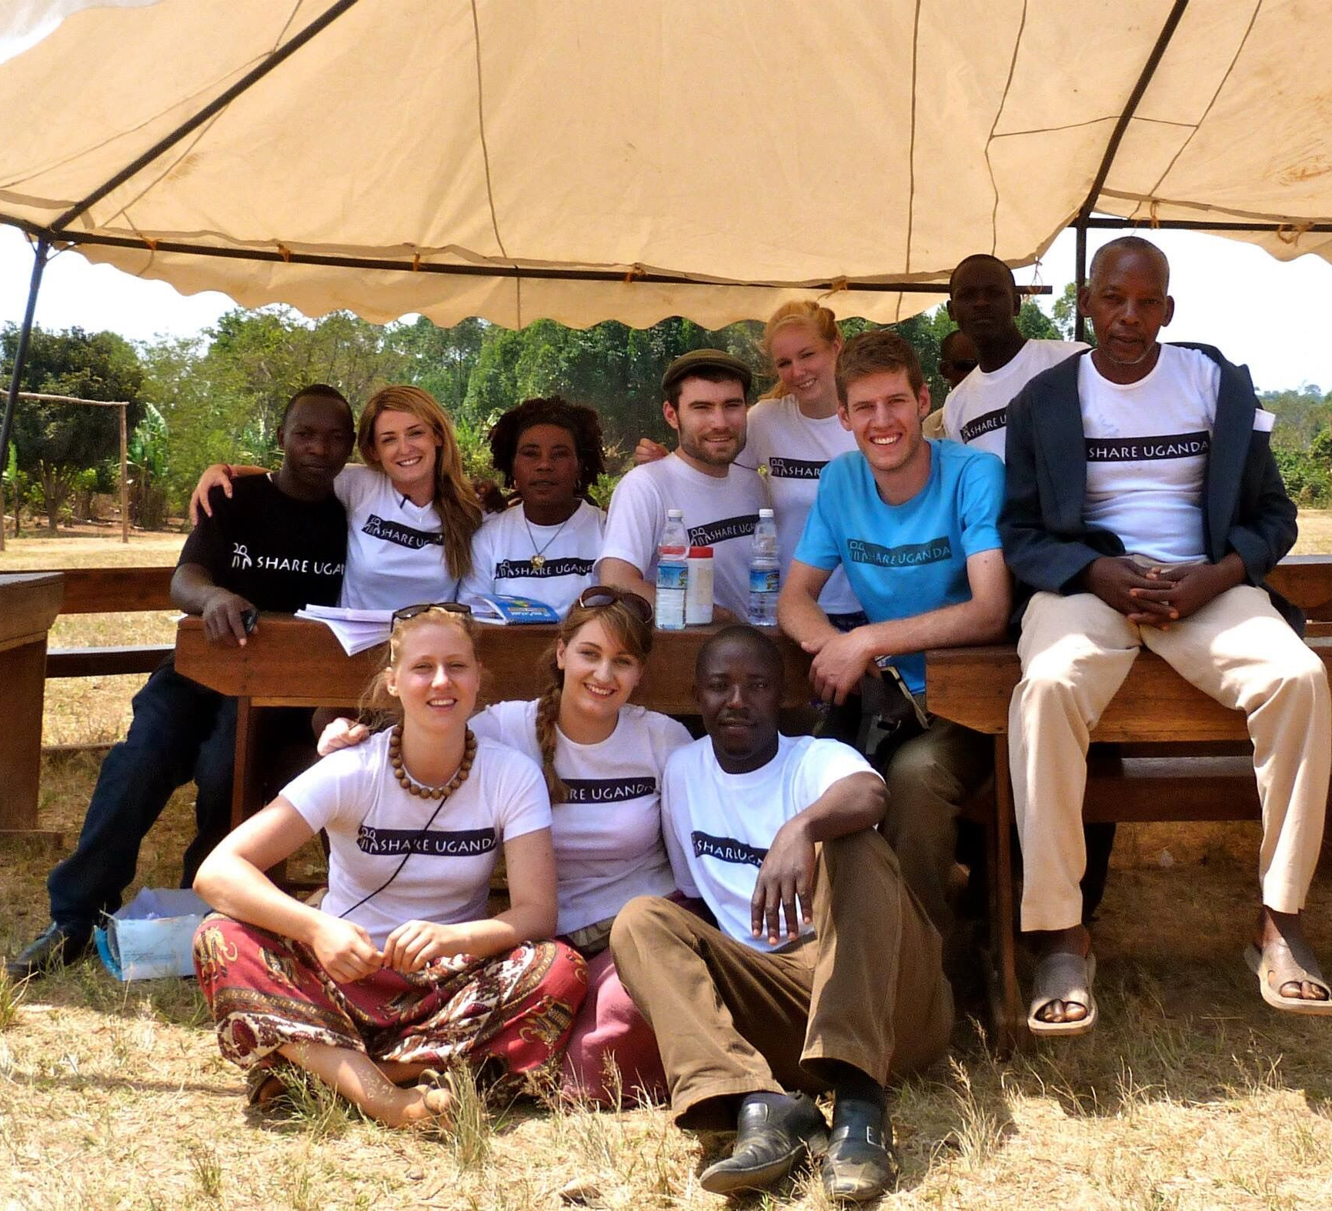
What can you do?
https://youtu.be/bqJFaK3jHpc
“Never doubt that a small group of thoughtful, committed, citizens can change the world. Indeed, it is the only thing that ever has.”
Notes:
So what can you do?
As young people, from Northern Ireland, you all have an incredibly positive position to stand from in tackling inequality and achieving social justice.
No one can do anything, but we can all do something. Everyone has something within their unique skill set that makes a difference – whether it is fundraising for NGOs like Share Uganda, whether it is taking your campaign to politicians, whether it is setting something up in your school – everyone can achieve something.
We will now watch this video that shows how young people can get involved in making a change – something this series of classes is going to take a look at.

