Slide 1
“You can't do everything, but you can do something”
Notes:
These classes form the basis of a series of classes that will discuss themes of global inequality, social justice, and how young people can all play their role in society.
This is brought to you from a Share Uganda, an NGO based in Northern Ireland and Kabira village in Uganda that is rooted in youth participation and involvement in activism and making the world a better place.
The classes aim to provide awareness of social justice and inspire a new generation of thinkers in these areas. Share Uganda was created with the belief that we all have a role to play in this world, and with a desire to take new approaches to change and empowerment. These classes hope to share similar values and ideas with young people.
Our ethos is the idea that you cant’ do everything but you can do something. This is the belief and knowledge that every single person holds within them the ability to make change in the world should they so want to. It is about finding what you’re passionate about, what drives yiu, and doing what you can – no matter how big or small – to contribute to making positive change.
These classes are hopefully gong to provide some insight to this, and maybe some inspiration. This first class is going to give an overview of some of these themes.

Slide 2
What is an NGO?
A non-governmental organization (NGO) is any non-profit, voluntary citizens' group which is organized on a local, national or international level.
NGOs perform a variety of service and humanitarian functions
Some are organized around specific issues, such as human rights, environment or health.
Notes:
NGOs are an important part of civil society. They are important in bringing about awareness and change to issues that affect real people. Without NGOs, we often wouldn't be aware of some of the things going on in the world around us, and in our local communities. Being rooted in civil society, NGOs can make a massive impact at a local level – helping the people and communities who really need it.
Notes for teachers:
Encourage students to consider what NGOs they have heard of
Encourage thoughts about what NGOs do – what areas they work in (eg. Health, poverty, mental health, homelessness, water, malaria etc)

Slide 3
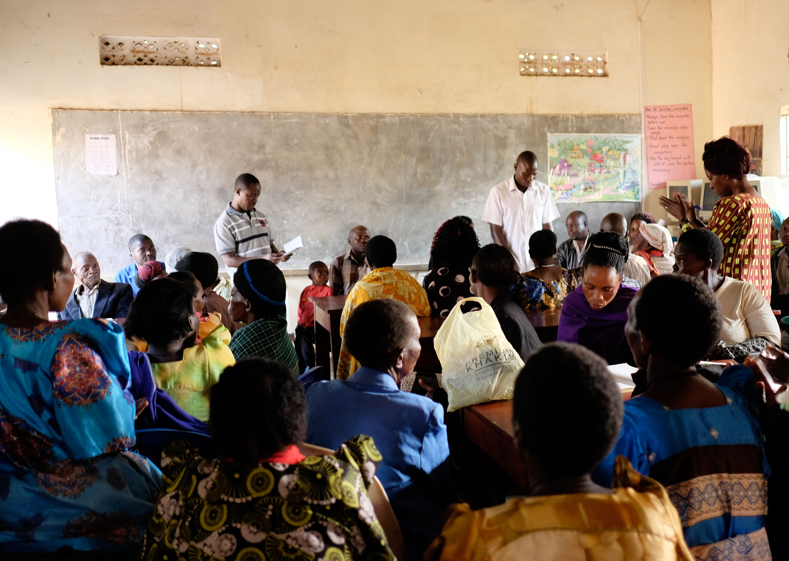
Inequality
Inequality is the difference in income, wealth, health, education, access to technology, opportunity and power among countries, communities and households around the world.
Can be caused by where you come from, your nationality, your race, your gender, your religion, your ethnicity, your identity
Notes:
One of the key things we were looking at in the series, is this idea of inequality.
Share Uganda works in tackling the healthcare inequality around the world, but there are so many different sources and types.
It is defined as the difference in income, wealth, health, education, access to technology, opportunity and power among countries, communities and households around the world. Inequality can be caused by where you come from, your nationality, your race, your gender, your religion, your ethnicity and your identity
It impacts each and every one of us on a daily basis in a variety of different ways. We need to be aware of this to be able to improve our lives and those of everyone around us.
Notes for Teachers:
Encourage students to think about what inequalities they see around them
Encourage ideas about what can cause inequality
Is it something they see in their home town or in their school or country? What differences do they see between people – in how they look, what they have access to and so forth? Does this impact how they are treated? Should it?
Are there any knock on effects or other consequences of being treated differently, or not having access to something?
Can students give their own definitions?

Slide 4
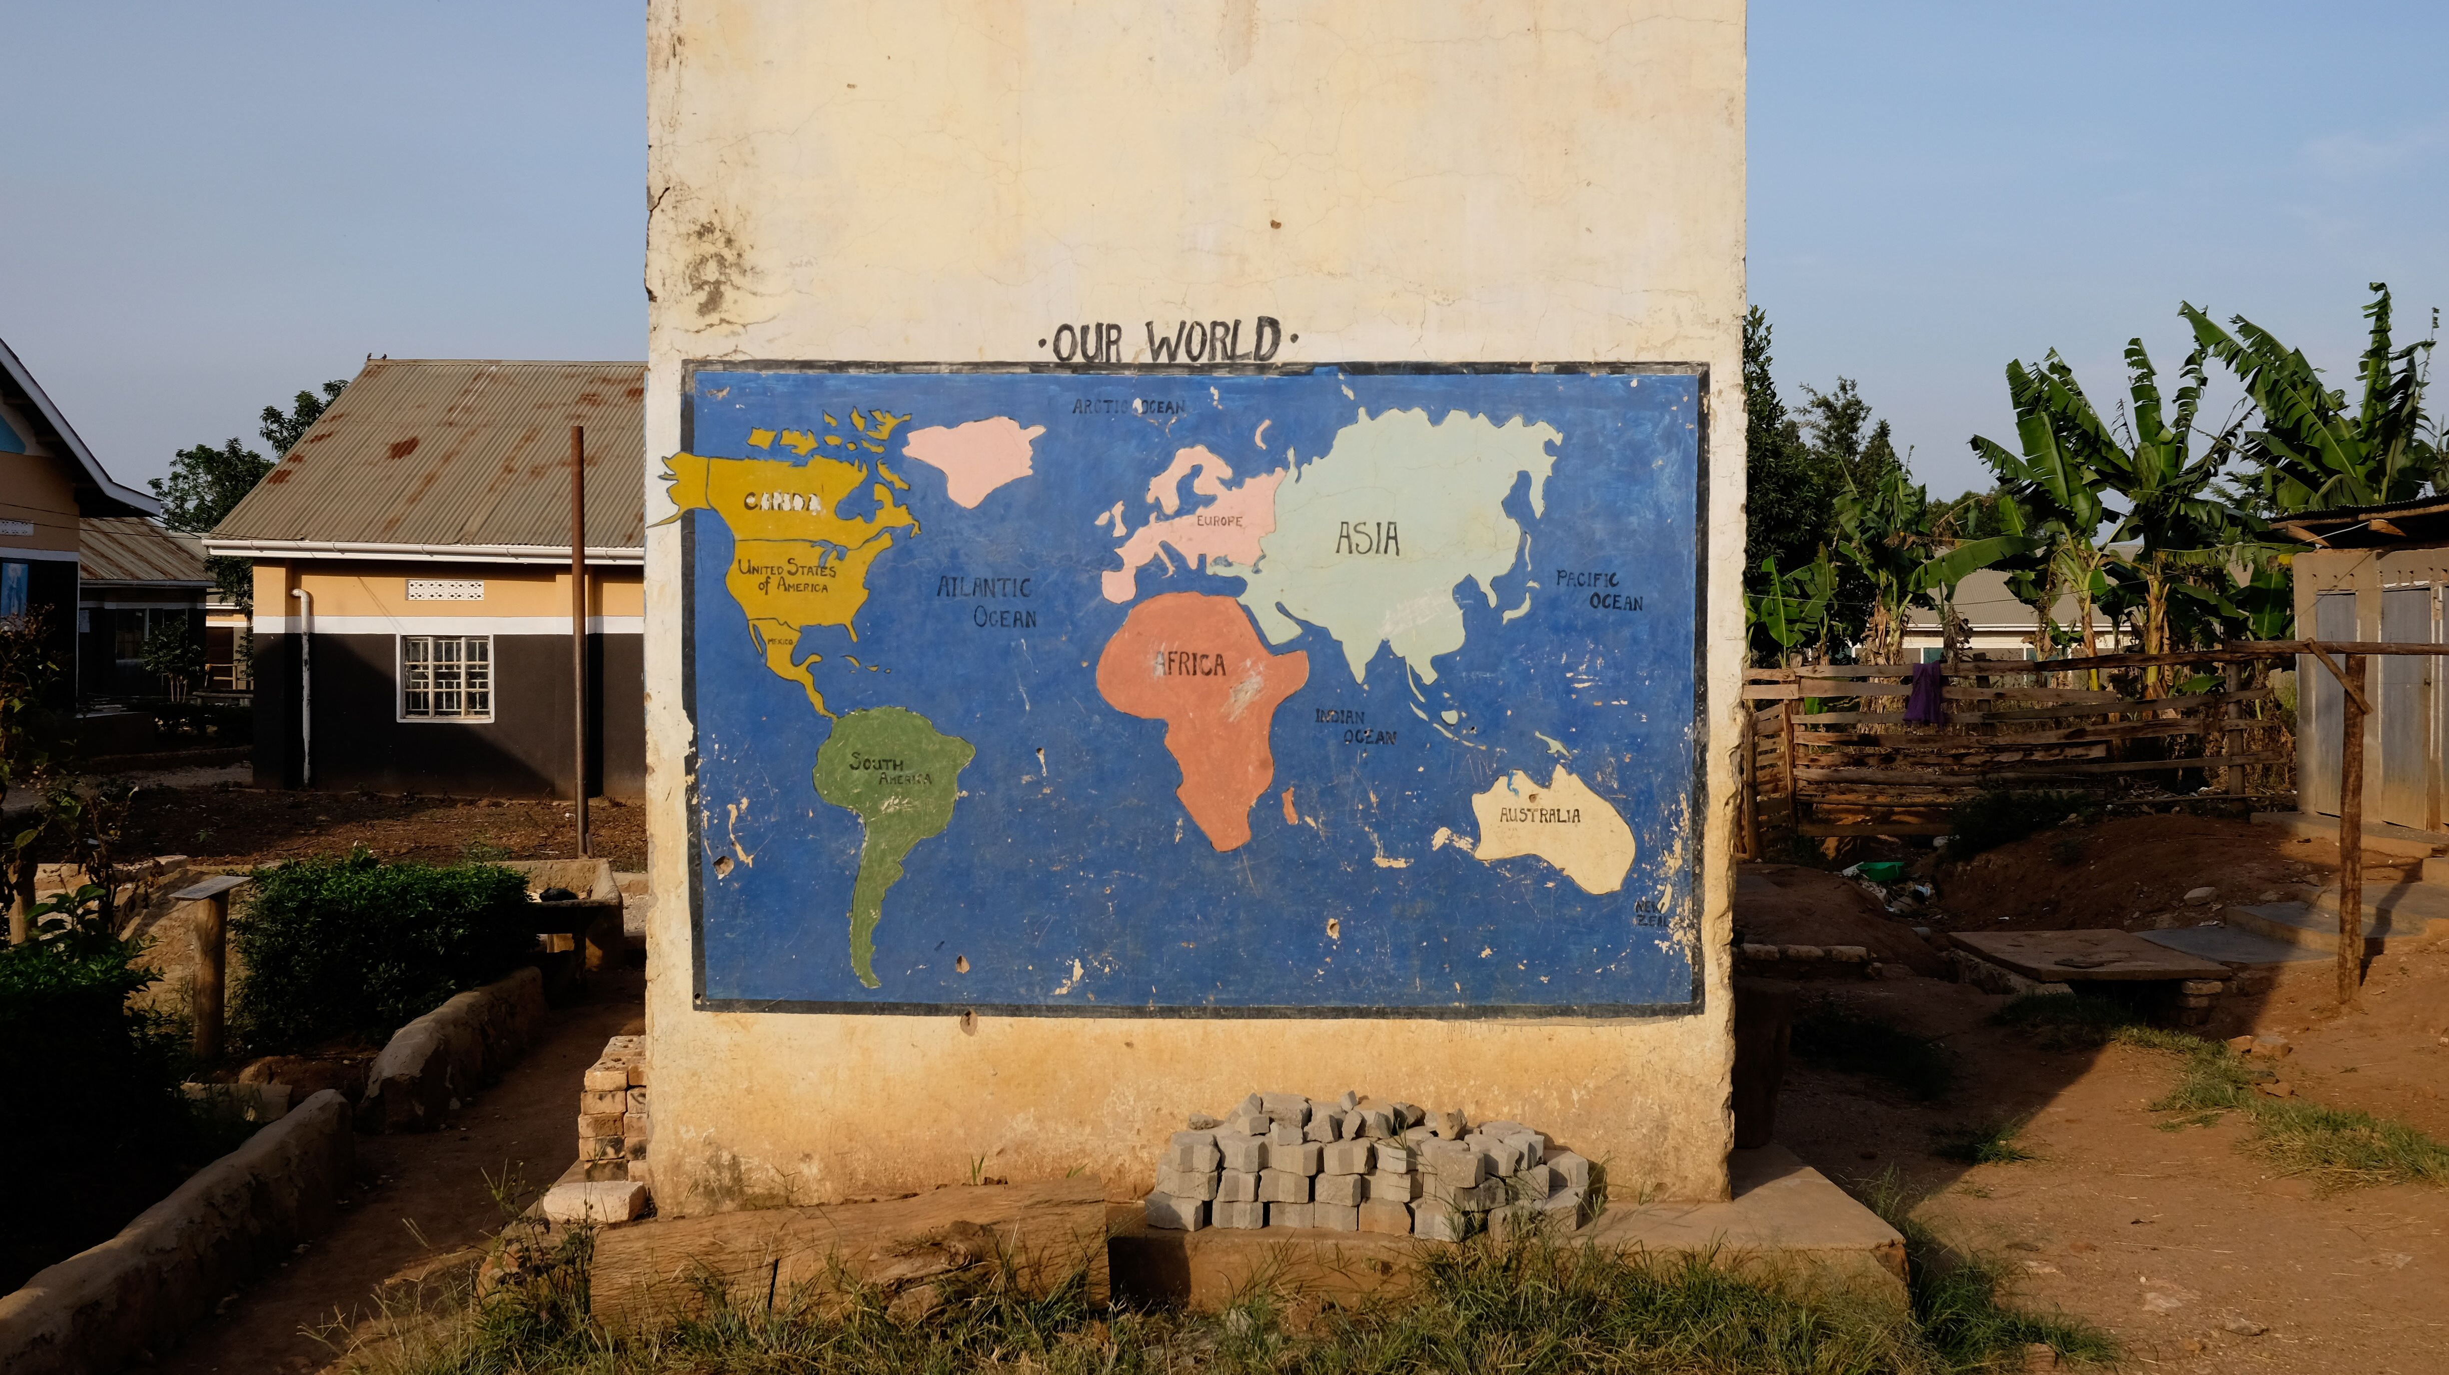
Social justice
Social justice is based on the concepts of human rights and equality
It is about the way in which human rights are manifested in the everyday lives of people at every level of society.
Justice in terms of the distribution of wealth, opportunities, and privileges within a society.
Notes:
What can NGOs and Young people do then…..
We can focus our attention to this concept of social justice.
Social justice is understand as fairness based on the ideas of human rights, equality and equity. It is about the way in which human rights are manifested in the everyday lives of people at every level of society. It is about justice or fairness in how wealth, opportunities and privileges are distributed within a society.
Its important to remember that we all have our part to play in achieving social justice and that it is an ongoing process.
Notes for teachers:
- Social justice in school – what can cause a lack of fairness? What can they do to address that?

Slide 5
Individual Responsibility
About the responsibility that every person has towards society.
It is about being sensitive, aware of and engaged in social, economic and environmental issues
Can involve activism which is the use of direct and noticeable action to achieve a result, usually a political or social one.
Notes:
The final thing this series of classes is going to explore is individual responsibility.
This is about the responsibility that every single person has towards society. We live in a system where our lives are intertwined and connected - a system where if we help others and do something to benefit others, chances are it will benefit us as well.
Having individual responsibility is about being sensitive, aware of and engaged in social, economic and environmental issues. It can involve activism which is the use of direct and noticeable action to achieve a result, usually a political or social one.
Notes for teachers:
- Encourage a discussion about how they can take individual responsibility in their homes and their schools – how does this benefit them and their family/peers?

Slide 6
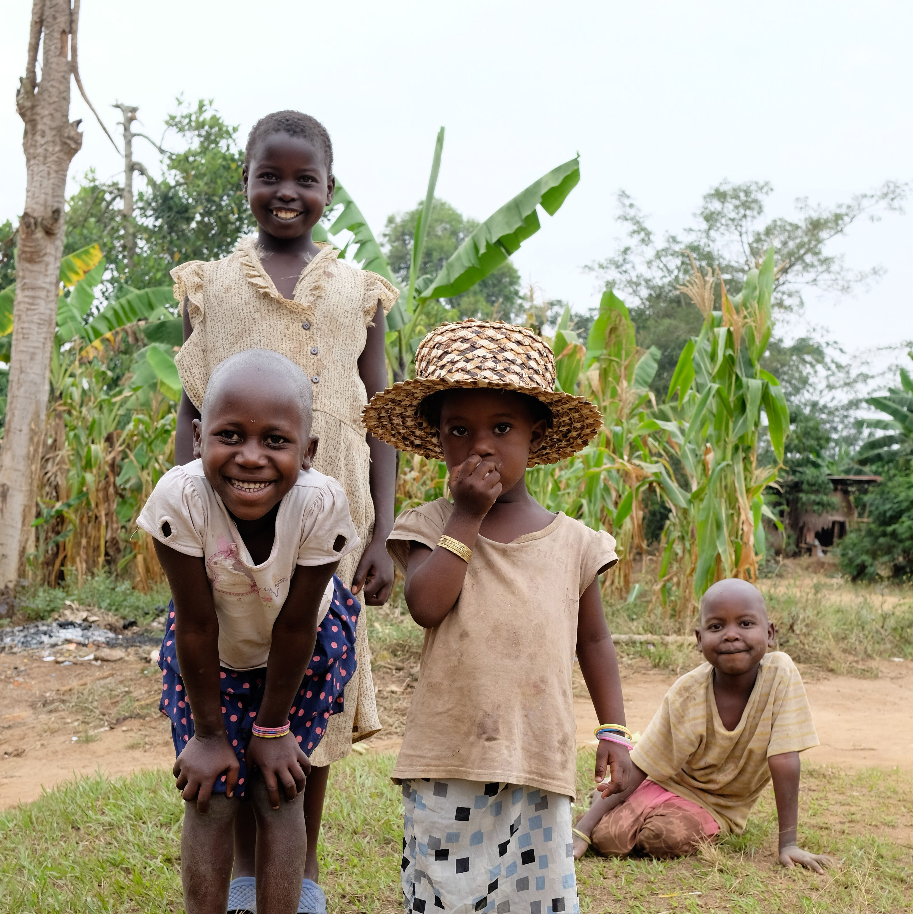
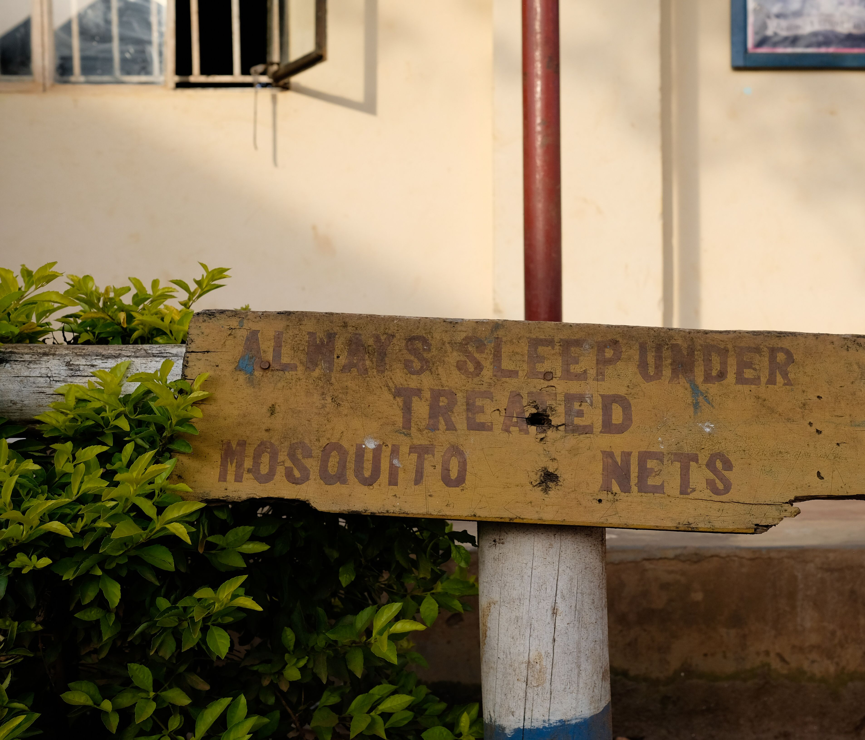
Share Uganda
Share Uganda is an entirely not-for-profit, community based healthcare organization working in the Kyotera District of Uganda.
The work carried out by Share Uganda focuses on tackling the inequality issue
Share Uganda was set up in 2008 by 5 students from Northern Ireland
2018, opening of the Share Uganda Hampton Health Centre
Notes:
Who are Share Uganda?
- We are an NGO;
Main issues to tackle include health care access and the malaria crisis. Including providing sustainable health services and supporting the education of local healthcare professionals
We distribute malaria nets, constructed a Medical camp , planted a forest of eucalyptus trees, initiated a malaria prevention programme, which has been incredibly successful.
We focus on the inequality issue surrounding healthcare, and access to healthcare. Its important to remember that the healthcare facilities we have in the UK are a privilege and that the majority around the world, do not have access to that same privilege.
Set up by people from NI along with community leaders in Uganda.
Medical camp – in it’s first day it treated over 500 patients
Share Uganda has always been committed to taking new approaches to development and empowerment, through building meaningful friendships and relationships with communities. Only through community engagement and holistic thinking can NGOs contribute to the empowerment of local people.
Learn more through our podcast - https://open.spotify.com/episode/3bpaxofITtc2p5JV28wBcb?si=p5v0VoGzReWyKs4Dkkb7VA

Slide 7
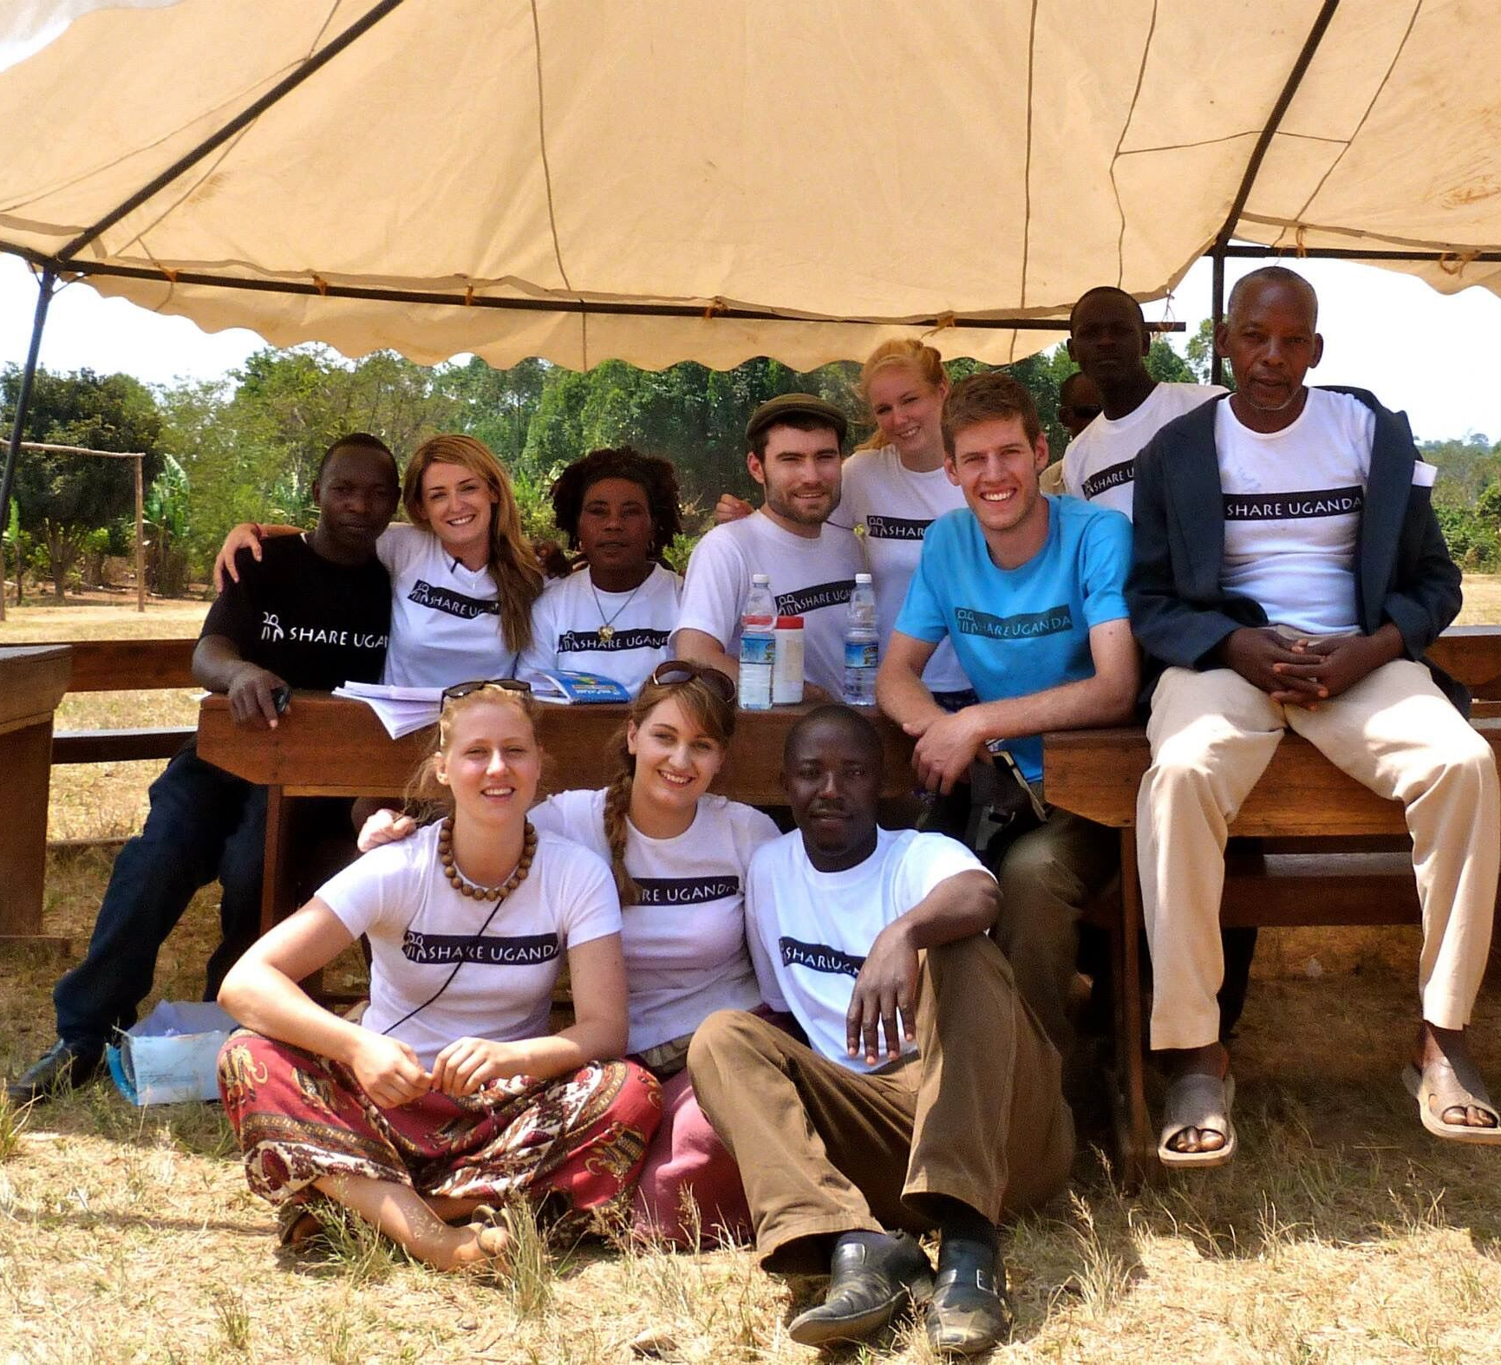
What can you do?
https://www.youtube.com/watch?v=5fLaAEMeb90
“Never doubt that a small group of thoughtful, committed, citizens can change the world. Indeed, it is the only thing that ever has.”
Notes:
So what can you do?
As young people, from Northern Ireland, you all have an incredibly positive position to stand from in tackling inequality and achieving social justice.
No one can do anything, but we can all do something. Everyone has something within their unique skill set that makes a difference – whether it is fundraising for NGOs like Share Uganda, whether it is taking your campaign to politicians, whether it is setting something up in your school – everyone can achieve something.
We will now watch this video that shows how young people can get involved in making a change – something this series of classes is going to take a look at.
[quote: Margaret Mead]

