Slide 1
“You can't do everything, but you can do something”
Notes:
This class takes a look at inequality.
Inequality is something that surrounds all of us and exists all around the world – from the UK to the USA to Uganda.
It is something that Share Uganda, and many other NGOs work to try to address. We look at it from the approach that while you can’t do everything, you can do something.
This class is going to leave students with a greater understanding of the dynamics of inequality and how it can manifest

Slide 2
MENTI
Question:
What does ‘inequality’ mean to you?
Notes:
Teacher’s notes;
Using https://www.mentimeter.com/ to allow students to anonymously and autonomously contribute to class ideas and share their ideas.
Teachers can pre-prepare this slide by visiting the site and generating a code. This code can then be added to this slide.
Students then go to https://www.menti.com/ on their electronic devices and enter the corresponding code. This will then allow them to enter in their ideas to the question. All answers will show up on the screen in your preferred format.
Suggested introductory questions include
What does inequality mean to you?
Can you think of any examples?
What are the impacts of inequality?
Do you think it’s okay to have inequality in our communities and in our world?
This task allows students to begin thinking independently. Controls can be placed on menti software to limit what students can type in as answers.

Slide 3
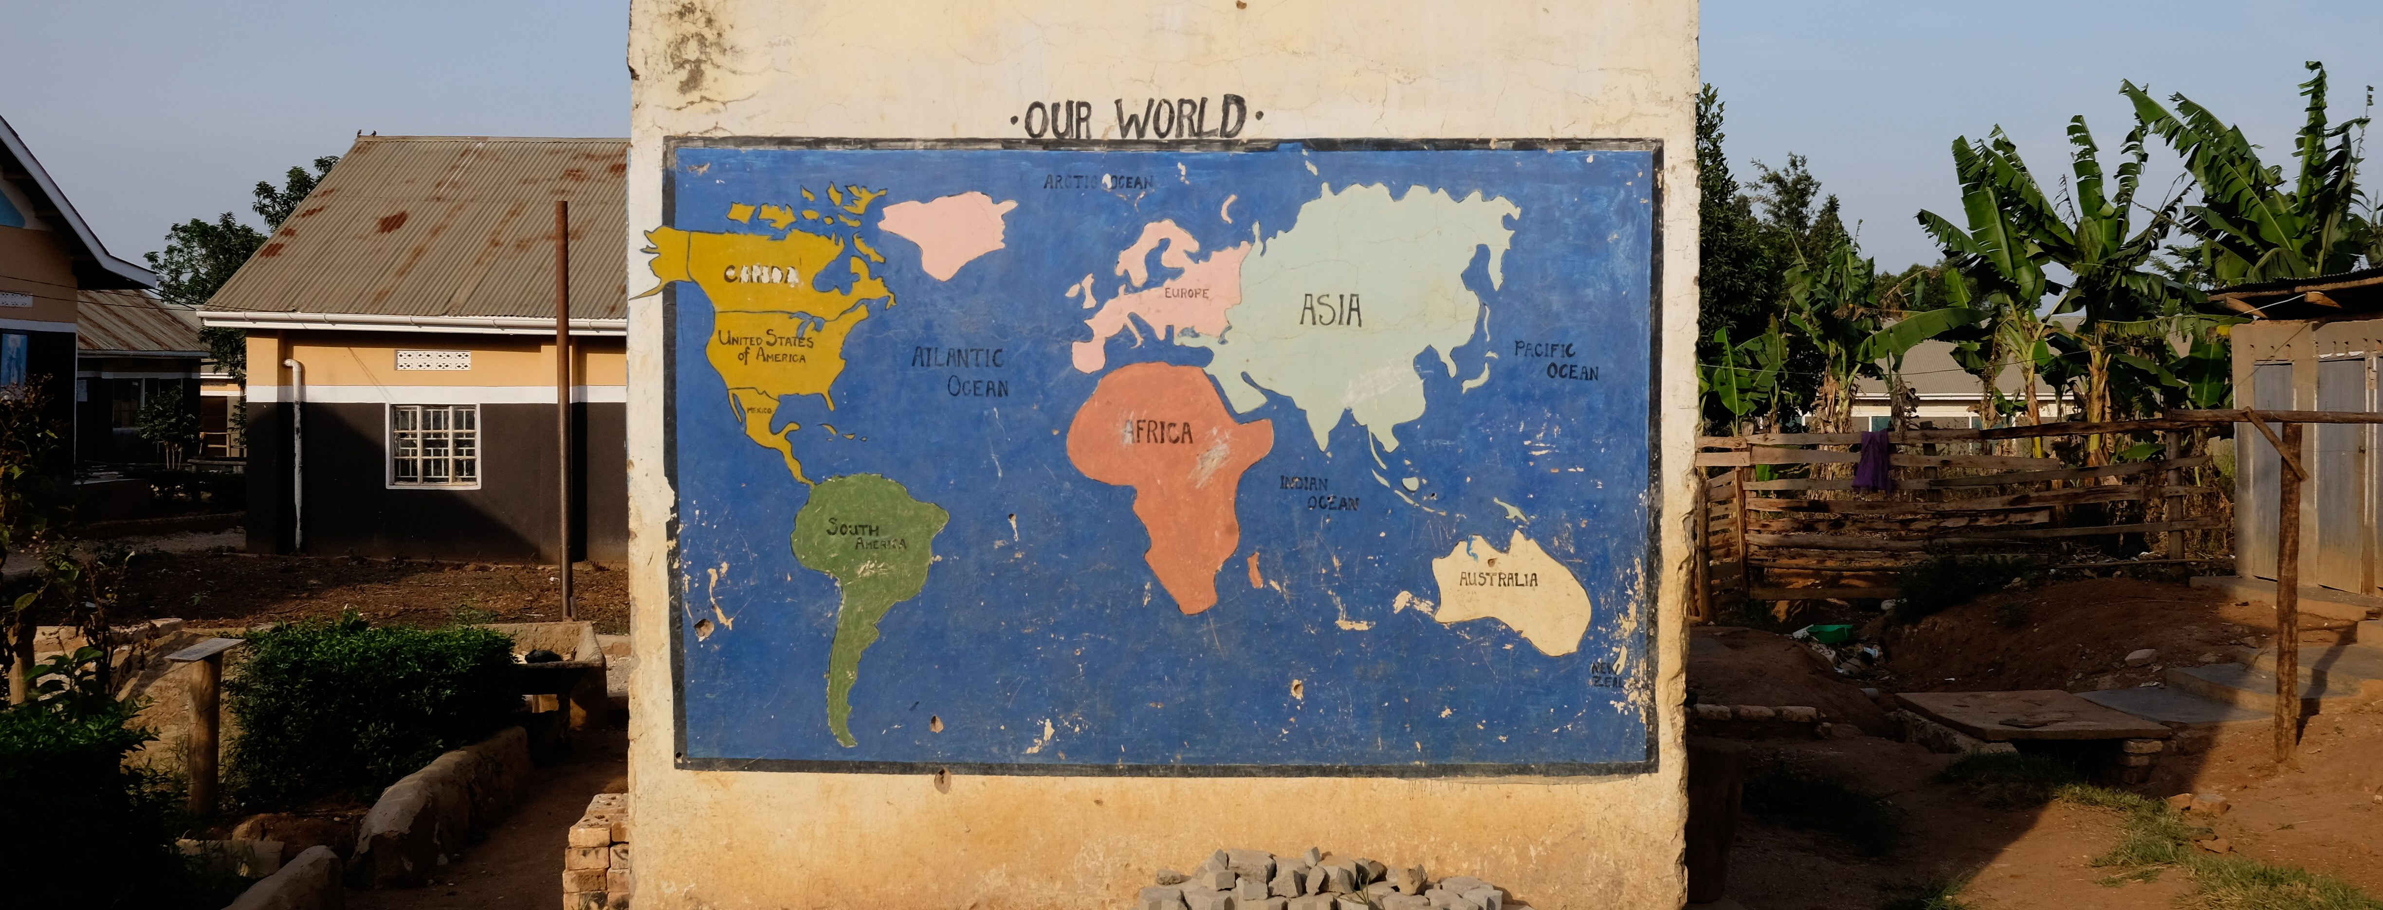
What if the world was 100 people?
https://www.youtube.com/watch?v=A3nllBT9ACg
Notes:
Students can now begin to consider what the world would look like if it were made up of only 100 people.
The linked video imagines the world in this way, and shows the differences in what people have access to, and what they don’t have access to.
Ensure students are active viewers by asking them to note down three things that surprise them, and one thing they would like to learn more about.
After viewing, there is the option of a follow up task to reimagine the class as representing the population of the world.
The room is to be divided up amongst the continents (North America, South America, Europe, Asia, Africa, Australasia).
Each student is given a continent and asked to move to their continent
Students then consider how the population is distributed. They are asked about what they would expect life to be like if they were from there – what language would they speak? How much money would they have? How big would their family be? And so on.
Then, the wealth of the world is distributed. I suggest using chocolate coins, but this is completely optional. Using the formula provided below, distribute the coins amongst the continents.
Students can now see how money is distributed around the world. Ask them to consider why it is distributed the way it is, and if it is ’fair or ‘equal’ – make sure to check in with why or why not. Always ensure that students justify reasons for their answers
Look for a class consensus – is this distribution fair? If it is not, what could we do to make a fair distribution amongst the class?

Slide 4
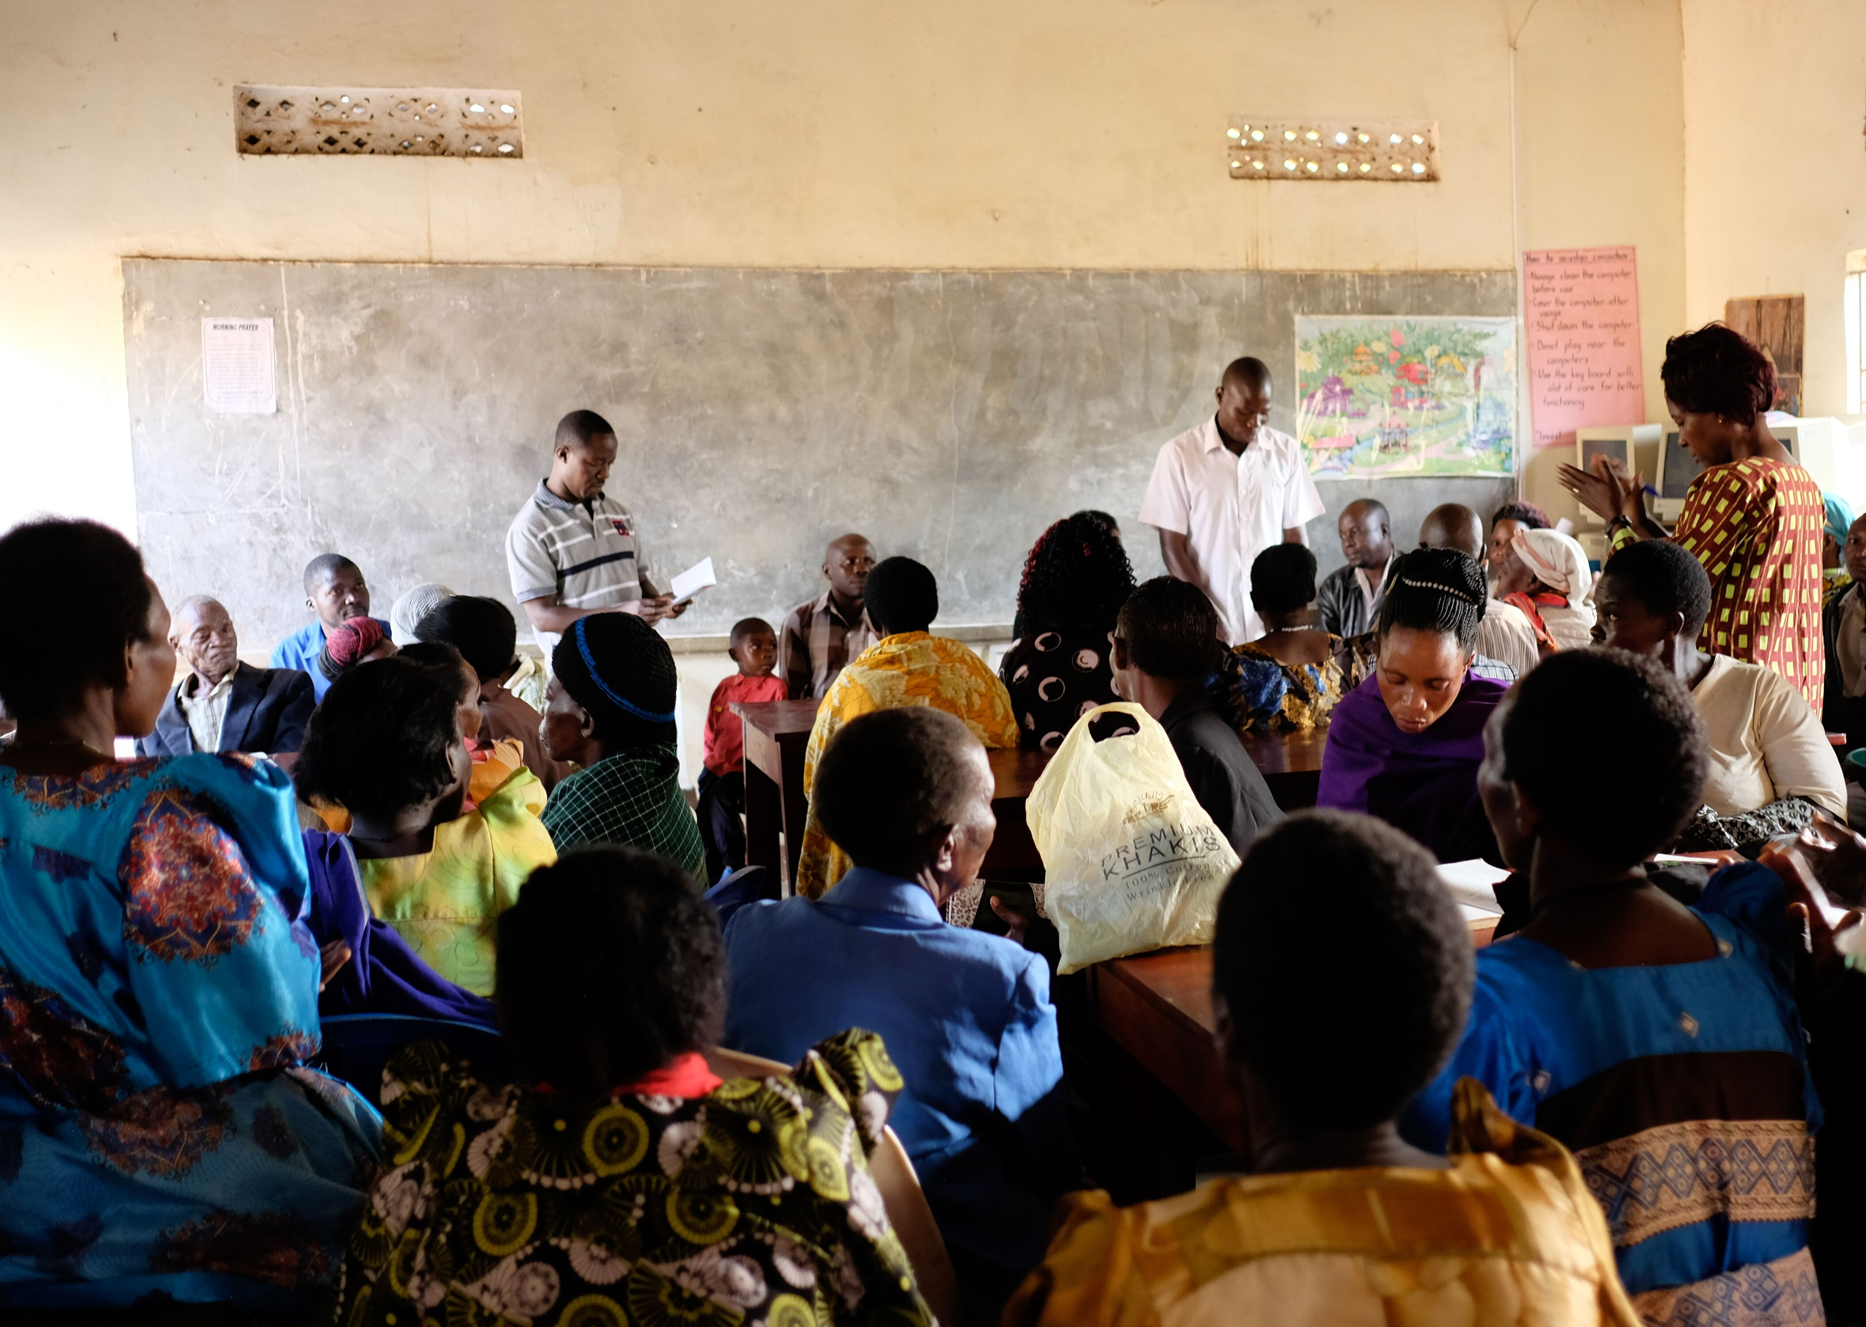
Global Inequality
Global Inequality is the systematic disparities in income, wealth, health, education, access to technology, opportunity, and power among countries, communities, and households around the world
Notes:
From what the students learned, can they give their own definition of inequality?
This is the official definition – can students now think of how it manifests in;
Their schools
Their communities
Their countries
The world
-Why does it happen?

Slide 5
Fact Checking
Which of these statements is true?
a) 5% of the richest people now have more wealth than the rest of the world combined
b) 10% of the richest people now have more wealth than the rest of the world combined
c) 1% of the richest people now have more wealth than the rest of the world combined
d) 7% of the richest people now have more wealth than the rest of the world combined
Answer: C
Notes:
True or False Game.
I recommend making this student lead.
Continue to ask follow up questions - what is their reaction to these questions and the answers

Slide 6
Which is true? High inequality is something which...
a) Mainly happens in poorer/less developed countries
b) Is not something that can be controlled
c) Is something that can be reduced by government actions
d) Increases in society over time
Answer: C
Globally women earn on average 23% less than men – it’s called the gender pay gap. At current levels of progress how long will it be before the gender pay gap closes?
a) 10 years
b) 75 years
c) 118 years
d)175 years
Answer: D

Slide 7
The richest half of the population is responsible for which percentage of the world’s carbon emissions?
10%
25%
70%
90%
Answer: 90%
True or false?
some countries have more mobile phones than toilets.
Answer: True - in India 53% of citizens have phones, only 36% have toilets
True or false?
half of the world lives on less than $2 per day.
Answer: True
Notes:
What would they prefer – to have a mobile phone or a toilet?

Slide 8
Which of the following things do you think can help to reduce inequality?
a) Taxes being higher for businesses and richer people
b) Having high quality, free education and healthcare available for everyone
c) Increasing wages for the lowest paid jobs
d) Giving support to poorer people – e.g. food credits
e)What else?
Notes:
This question can be done as a ranking task.
Students rank what they think is more effective in tackling inequality
Encourage them to be creative and think of other things that can be done – especially things that they themselves can do.

Slide 9
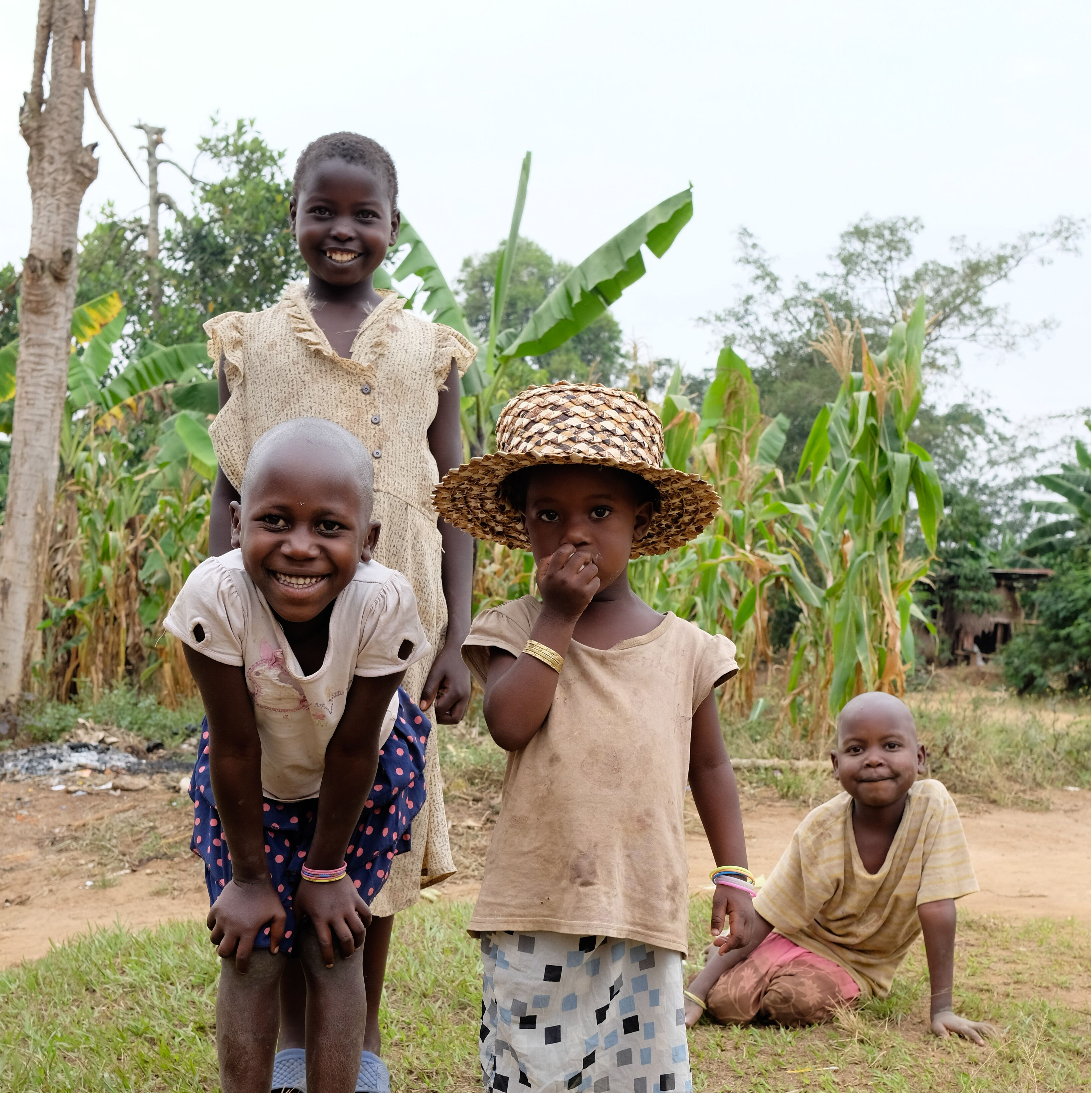
Inequality – the bigger picture
What types of inequality can there be?
What are the consequences of inequality in society and in the world ?
Imagine you are unwell and can’t get to the doctor……
Notes:
At this point, we ask students to consider that inequality is both a global and local problem.
Students need to come away with the awareness that this is something that impacts them and their families as well as people in other countries.
They also need to consider the wider impacts.
Scenario: imagine you are unwell and can’t get to the doctor
questions:
What are some reasons why you wouldn't’t be able to go to the doctor?
What could be possible consequences of this?
Why is it important to have access to good health care?

Slide 10
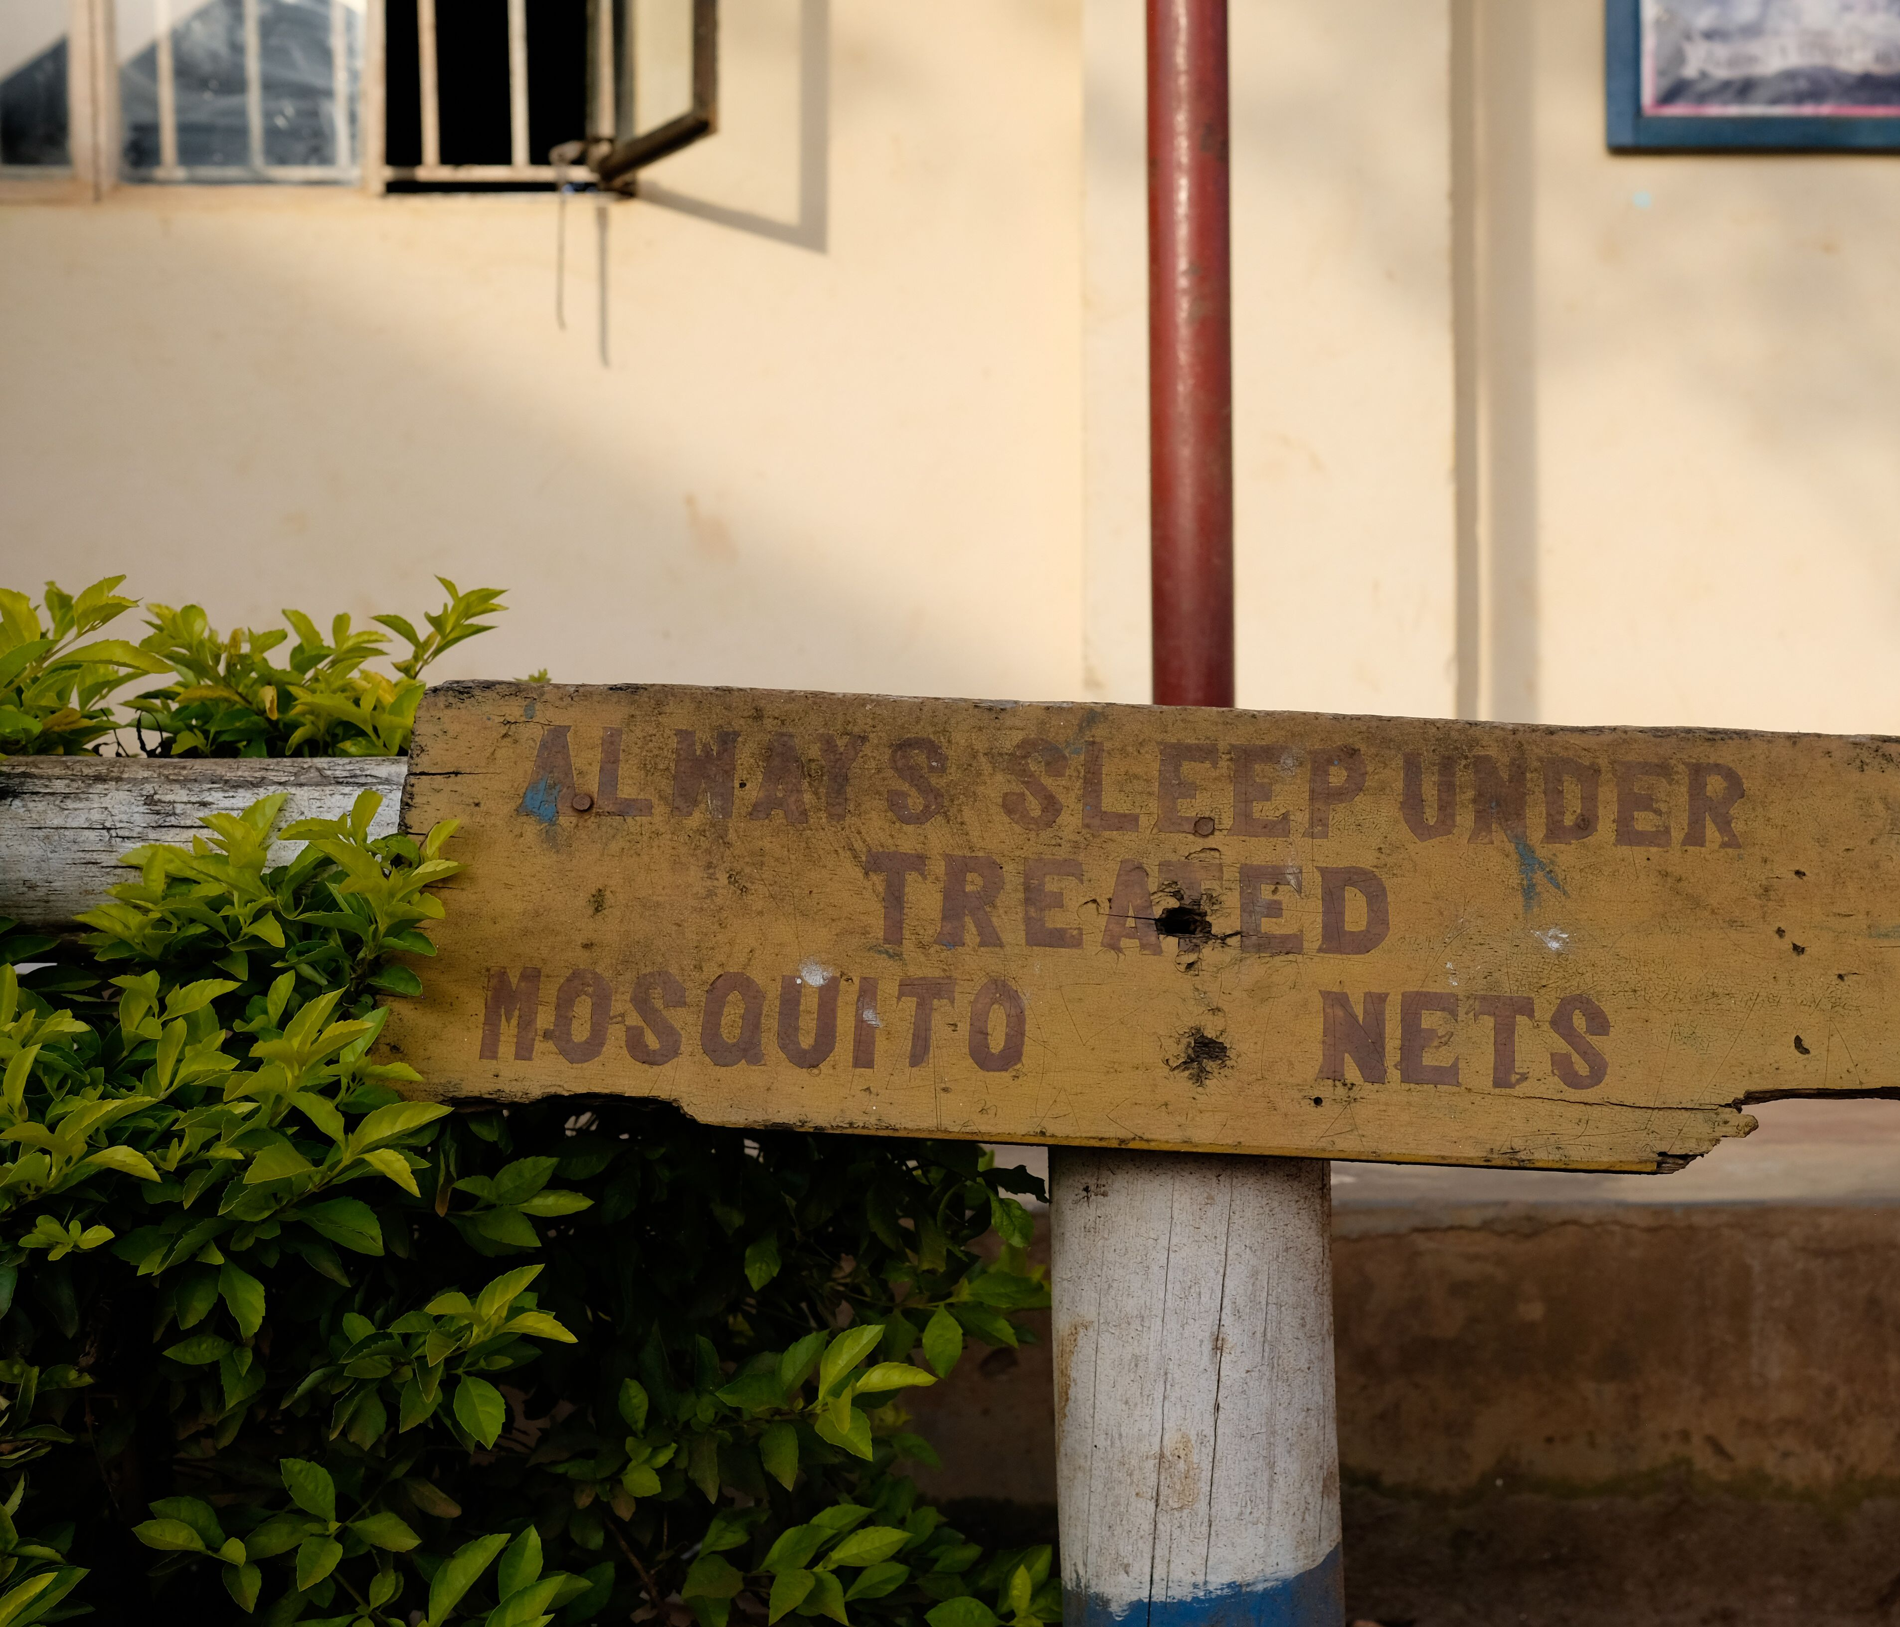
Public health inequality
Public health is the area that Share Uganda works in to address inequality and achieve greater social justice.
Where can we see public health inequality?
Globally?
Within nations?
Between nations?
What is the impact?
https://open.spotify.com/episode/3QnAsSj43hsJ3PQ1EzPcnq?si=FX1nw8iaSLSGVu9e0o2sgw
Notes:
Consider the difference between health care provision in different countries around the world
What is the difference between the UK and the USA, what is the system in the Republic of Ireland?
What is it like in other parts of the world?
Why is this a problem?
There is an insightful podcast episode that traces this concept - https://open.spotify.com/episode/3QnAsSj43hsJ3PQ1EzPcnq?si=FX1nw8iaSLSGVu9e0o2sgw

Slide 11
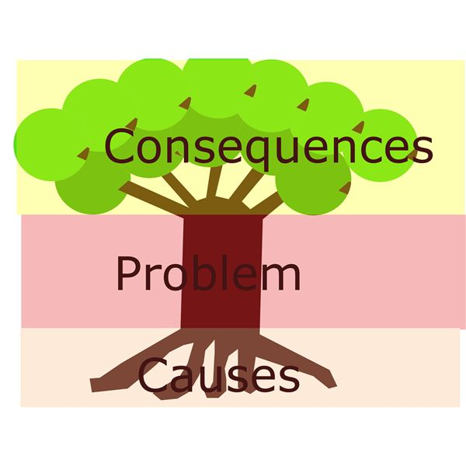
World Issues
Climate change
Racism
Poverty
Access to health care
Bullying
Notes:
Class activity
Ask class to consider and give examples of what different examples of inequalities they see or that they particularly care about
They then are split into groups
Each group picks a problem - this will be used for their ‘Issue Tree’
They draw the tree, and write the inequality within the trunk of the tree
they consider the causes and input these as the roots
They then consider the long term and follow on consequences and use these as the leaves.
This task can be done independently or students can use online research to guide their findings and promoting individual research skills.
Ensure to keep the finished tree – this will be used again later on in another class when they look at solutions.

