Slide 1
“You can't do everything, but you can do something”

Slide 2
NGOs
What is an NGO?
Can you think of an any examples?
Notes:
Teacher’s notes;
Using https://www.mentimeter.com/ to allow students to anonymously and autonomously contribute to class ideas and share their ideas.
Teachers can pre-prepare this slide by visiting the site and generating a code. This code can then be added to this slide.
Students then go to https://www.menti.com/ on their electronic devices and enter the corresponding code. This will then allow them to enter in their ideas to the question. All answers will show up on the screen in your preferred format.

Slide 3
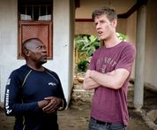
What are NGOs?
Non-governmental organisations (NGOs for short) are not for profit charities that deal with many different issues, including social injustices
They are not funded by the government and so have to do their own fundraising. This also keeps them neutral from government action
Their role is to reduce social injustices locally, nationally and internationally
It is important to ensure community engagement! Listening and Talking are key skills NGOs need to have
Notes:
What NGOs have you heard of?
What area do they work in?
Why do you think it is important to have NGOs? Why is it important that they are separate from the government?
Share Uganda has always been committed to taking new approaches to development and empowerment, through building meaningful friendships and relationships with communities. Only through community engagement and holistic thinking can NGOs contribute to the empowerment of local people. Community engamenet, and lsitening to people about their struggles and how we can help them is the only way to empower and create meanignul and susutaianbel change for the good.

Slide 4
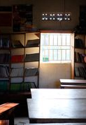
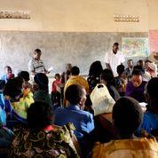
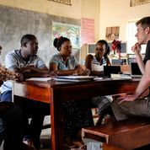
What do NGOs do?
They work to tackle social issues on different scales. Some work internationally, some work more locally.
They can be involved in;
Natural disaster relief
Poverty
Welfare
Animal rights
The environment
War
Human rights abuses
Homelessness
Health
What kinds of things can NGOs do?
Notes:
First, students should consider the different areas that NGOs can be involved in – they can do this by thinking about different NGOs they know of and what they do
After providing the list of the different areas they are involved in – ask them to consider what NGOs can contribute in these areas
In groups, students should take two areas and discuss different ways NGOs can be involv and contribute

Slide 5
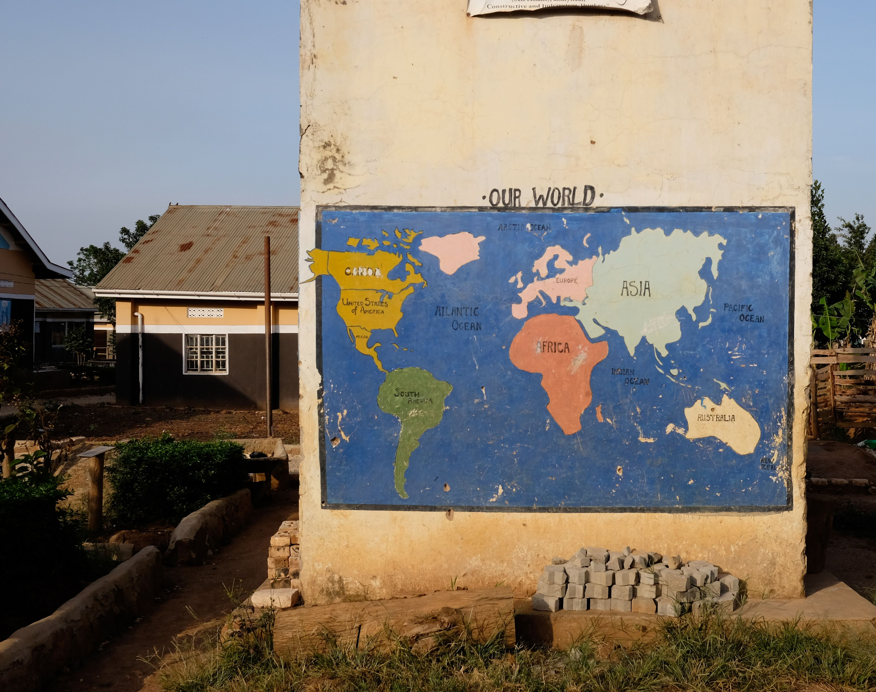
Activities of NGOs
They can run campaigns to encourage government action and to bring awareness to certain issues
NGO’s can create their own schemes and programmes that people can participate in
NGOs raise awareness about human rights and social inequality. This can encourage people to support their work.
They can help take action against countries that commit violations of international law and human rights abuses
They need to work in collaboration with the communities and people they want to help!

Slide 6
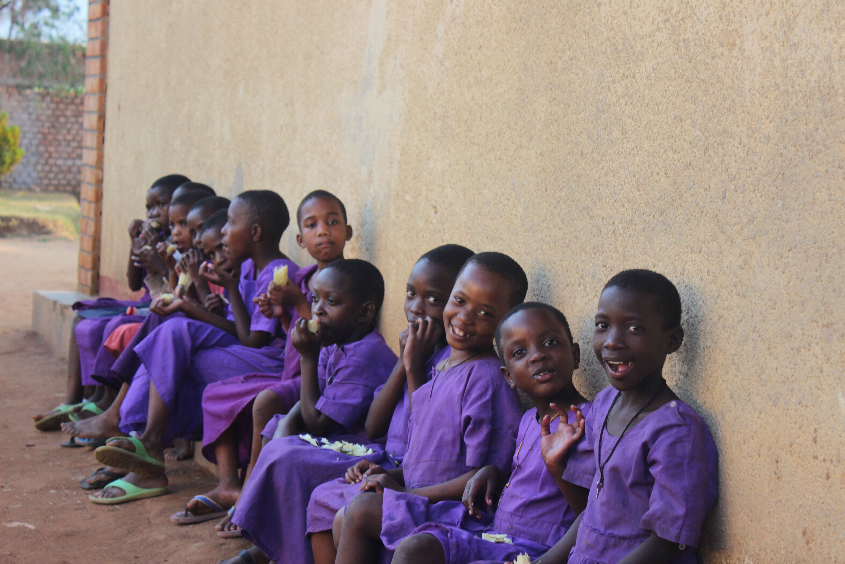
What can limit the work of an NGO?
Public support
Funding
Staffing, volunteers and resources
Corruption
Notes:
How can these things limit the work of an NGO?
How can NGOs mitigate these problems?

Slide 7
Share Uganda
A public health NGO, set up in 2008 by five students
It is community based and led by leaders in Kabira village, Uganda
Focuses on sustainable approaches to local health care challenges
None of the UK staff is paid
Entirely dependent on public donations
https://open.spotify.com/episode/3ZCbrQWk0LidwjuYpMeVeY?si=EXR7xCJQTTG9PtuiVRZATw
Notes:
Share Uganda focuses on taking a holistic approach. This involves building meaningful friendships, listening to people, collaborating on responses, and empowering local leadership and decision making.

Slide 8
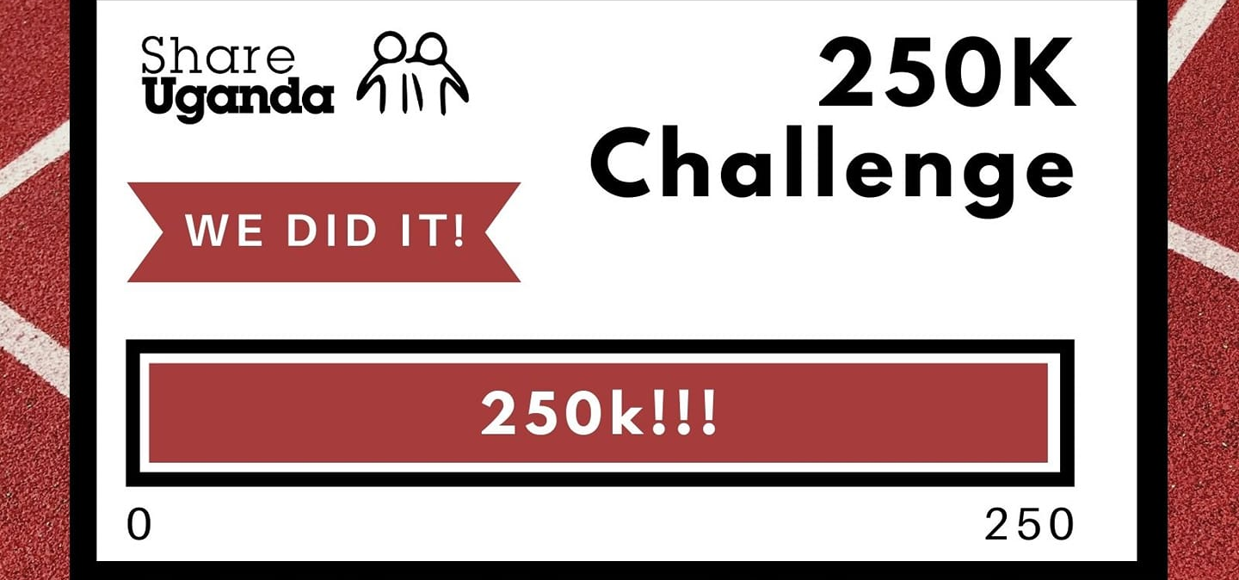
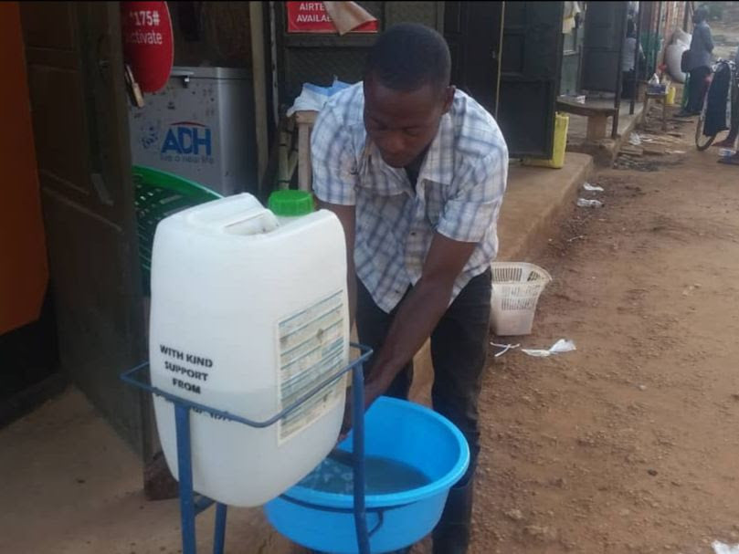
Share Uganda
Run regular fundraisers in Northern Ireland
Backed by student groups at Queens University Belfast and Nottingham University
Money raised goes into supporting projects that are led and inspired by local leaders
Money contributes towards education of local healthcare professionals, not paying staff in the UK
Core projects include
Opening a health center
Malaria prevention programmes
Tackling Covid-19
Notes:
At Share Uganda we believe in sustainable approaches to change. We believe in empowering local people, and moving towards community empowerment and development from the community, rather than dependence.
This means supporting education projects in the local community which will mean more trained medical staff in the area. This means creating financial stability – we have done this through planting a eucalyptus forest.
This also means taking a lead from local people. Decisions are made based on the input and information given to us by local leaders. All of the money raised for Share Uganda goes into supporting the projects that need it.
Fundraisers we have done recently include a socially distanced running challenge, the 250k challenge which raised over £2000. This has gone on to help support the Uganda team tackle Covid-19, including providing PPE for medical staff, setting up more handwashing stations, and continuing to provide outreach in the community.

Slide 9
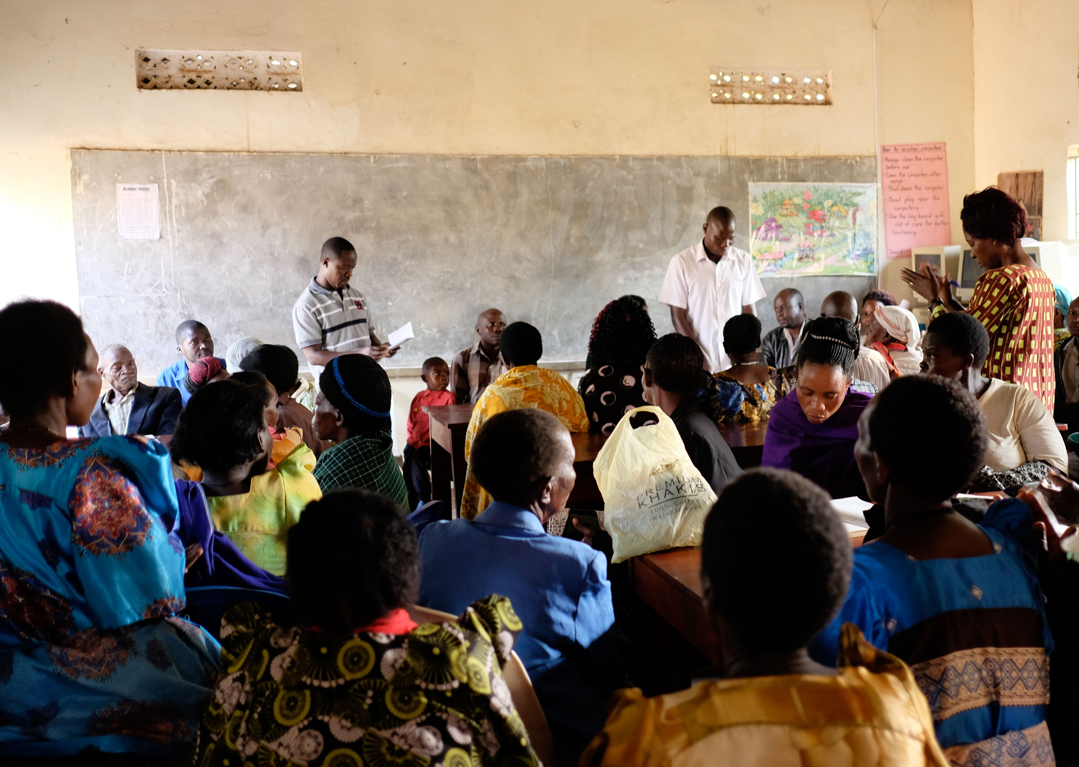
Share Uganda
All NGOs face limitations
What do you think these could be?
Funding! Share Uganda is entirely reliant on public donations. This requires a lot of work on behalf of the team and is dependent on peoples generosity
Staff! Share Uganda has no paid staff in the UK, this means we can be fully transparent with our spending, and means all donations go directly to the projects and community that needs it. However, it means that our board of directors and UK team members have to juggle Share Uganda with their other personal work commitments
Awareness! Share Uganda is a small charity. Only founded in 2008 by a group of 5 students, the growth and work we have achieved is impressive, but we are small and often unheard of.

Slide 10
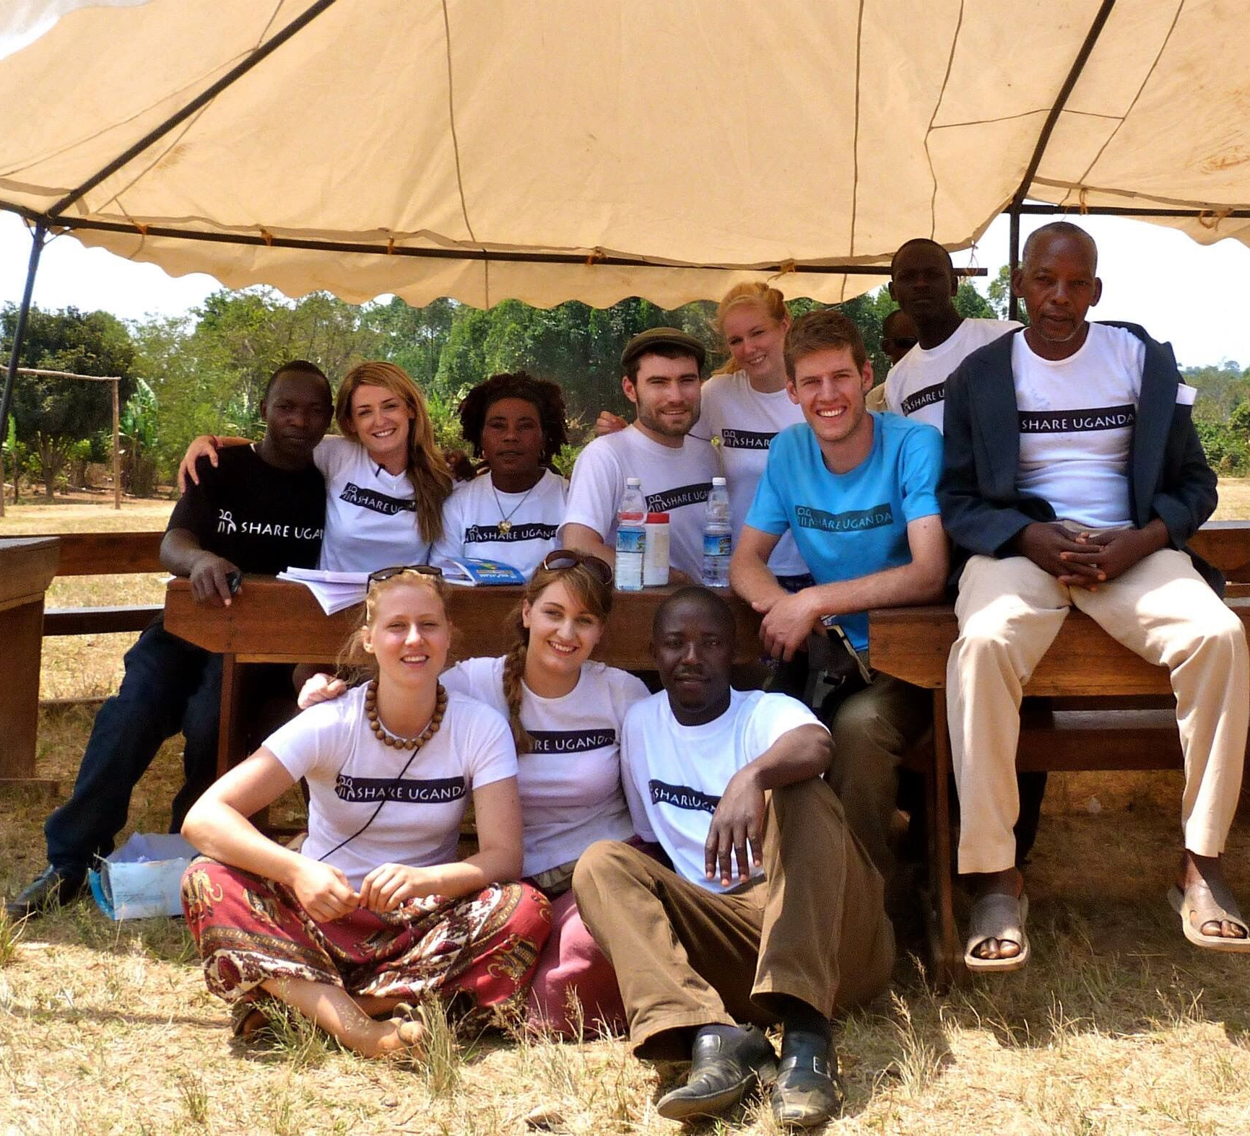
What can you do?
“Never doubt that a small group of thoughtful, committed, citizens can change the world. Indeed, it is the only thing that ever has.”
Notes:
Finishing Thoughts:
What ways do you think going forward you can contribute to making the world a little kinder, a little better?
This can be something big, or something small. Every piece of action has an impact no matter how big or how small, it all has to start somewhere.
Even just a friendly smile can make a difference to someone’s life.

